Slide 1

Oleksandr Lukashuk
Advanced Research Department
09.04.2020

Slide 2
Table of Contents: Overview
What is Unity & What is it Used For?
Unity 2D
Physics
Scripting
Audio & Video overview
Animation
X Reality (XR)
Platform development

Slide 3
What is Unity & What is it Used For?

Slide 4
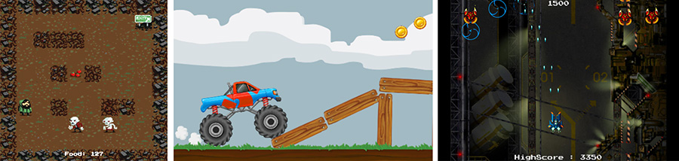
Unity 2D

Slide 5
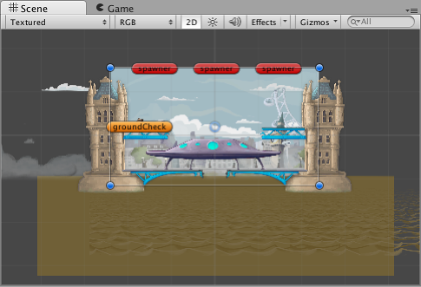
Gameplay in 2d

Slide 6
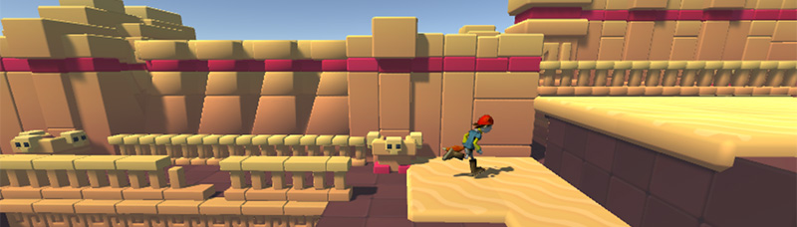
2d Gameplay with 3d graphics

Slide 7
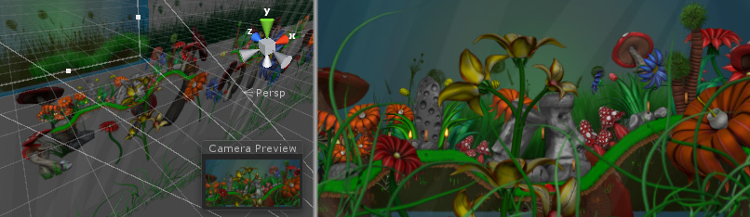
2D gameplay and graphics, with a perspective camera

Slide 8
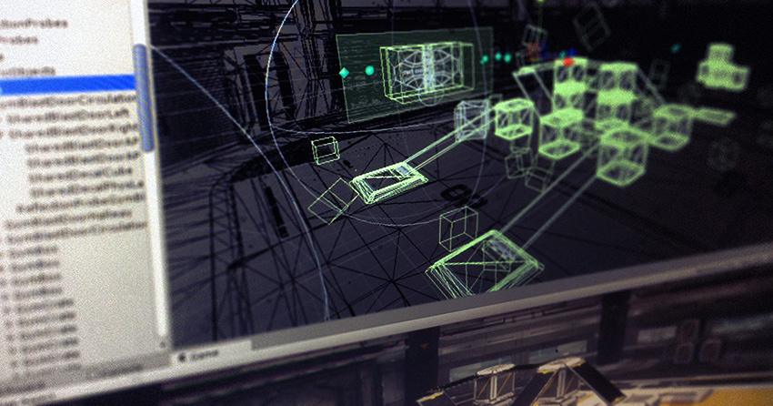
Physics

Slide 9

PhysX by NVIDIA

Slide 10
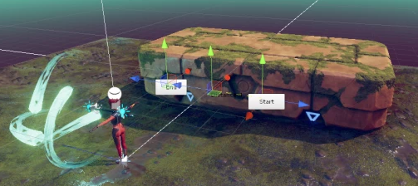
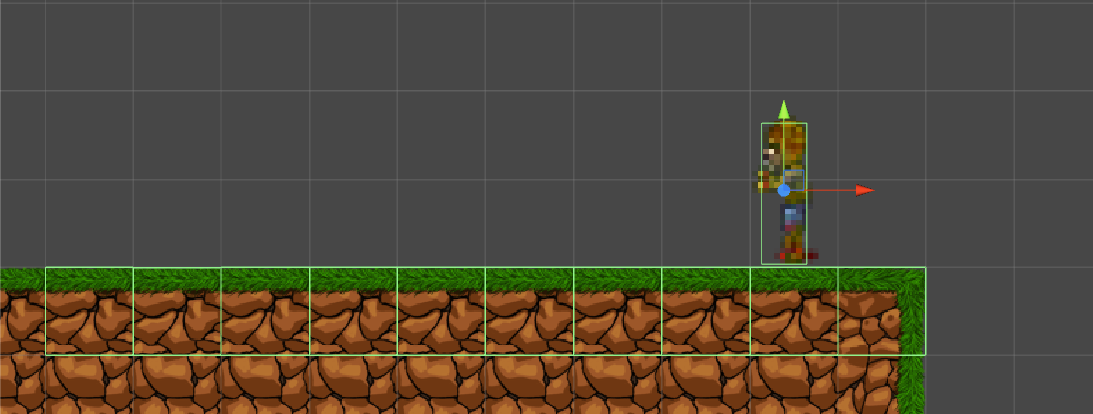
Physics Reference
Rigidbody overview
Colliders
Joints
Character Controllers

Slide 11
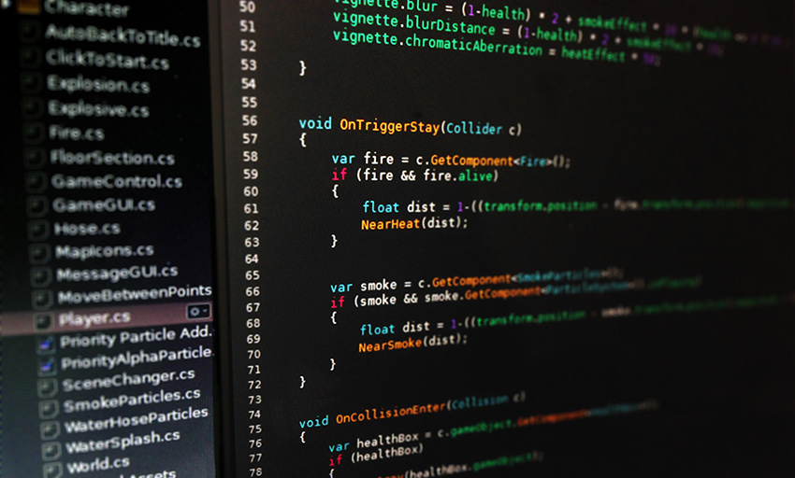
Scripting

Slide 12
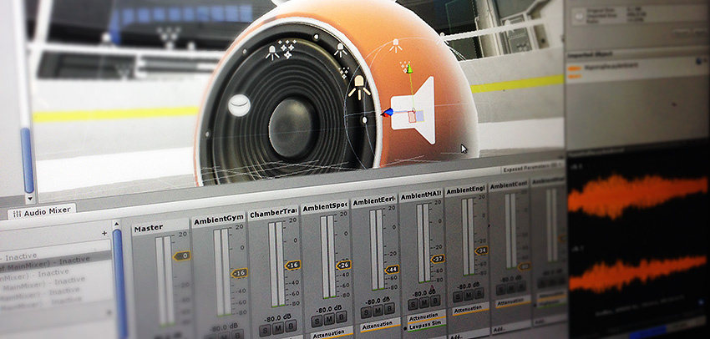
Audio & Video overview

Slide 13
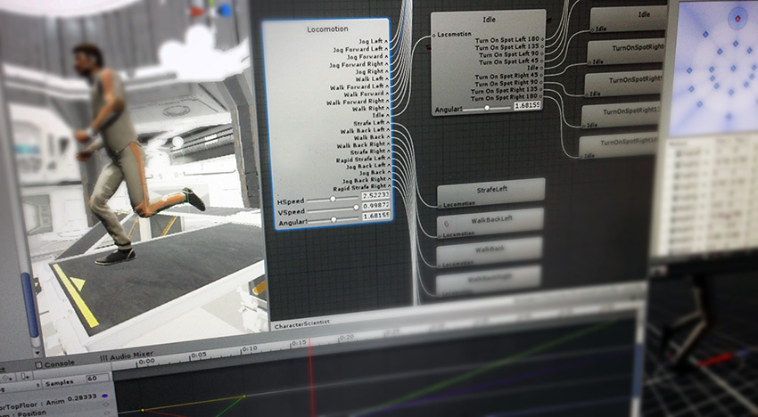
Animation

Slide 14
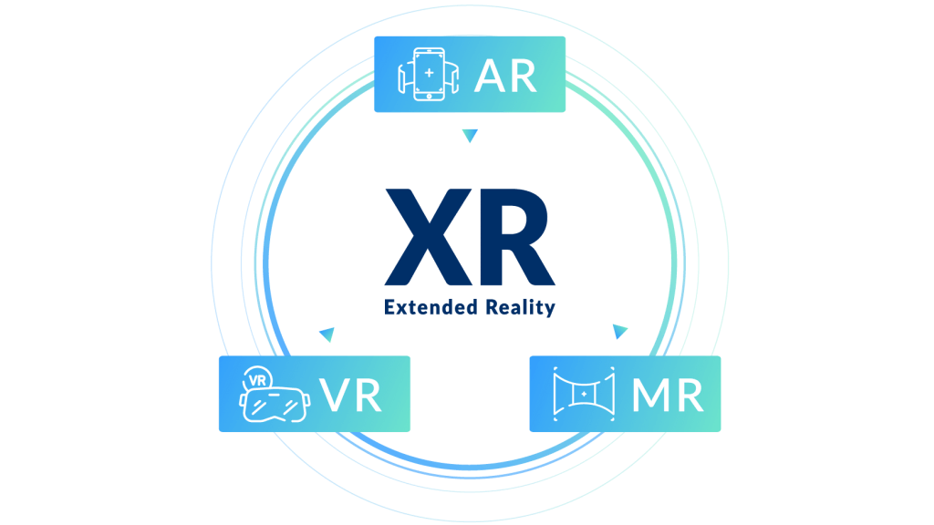
X Reality (XR)

Slide 15
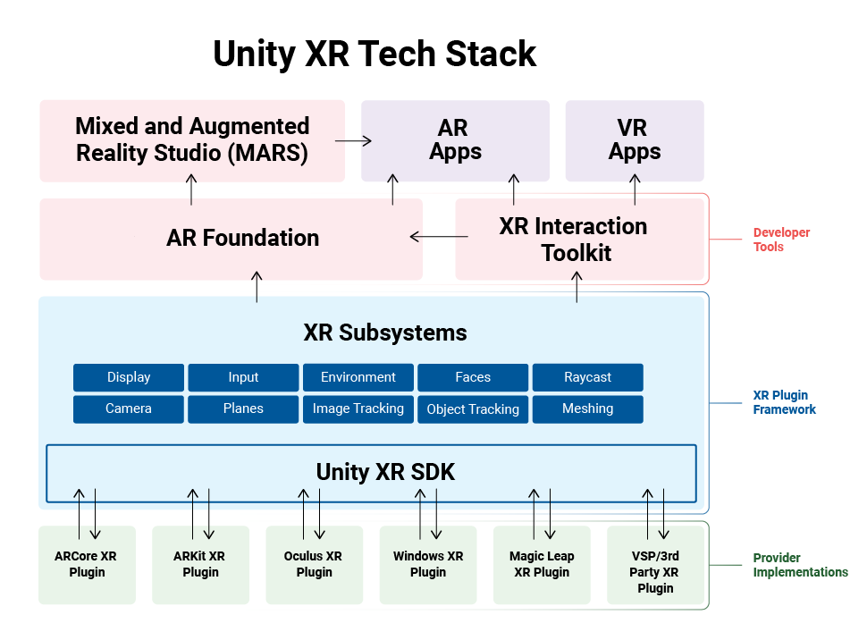
Unity XR plug-in framework

Slide 16

Vuforia Engine in unity

Slide 17
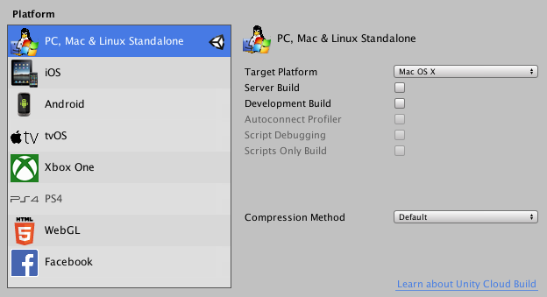
Platform development

